Slide 1
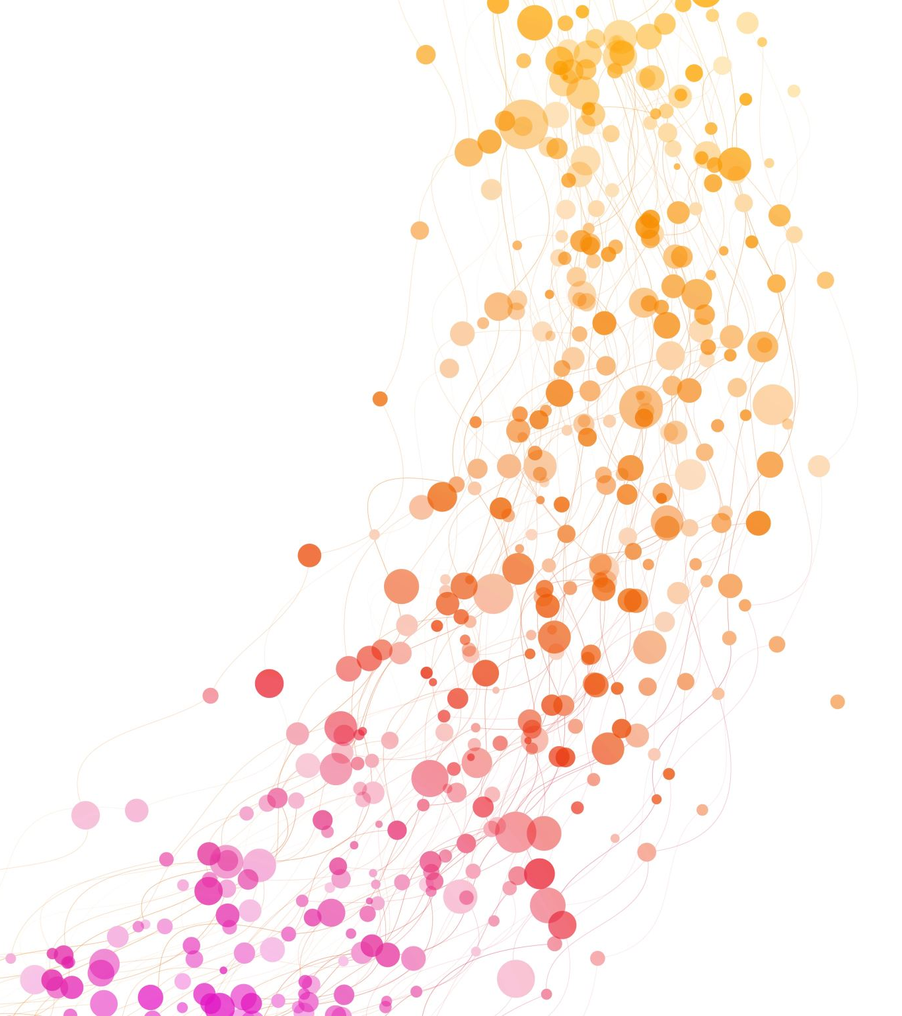
COST- Unit 5
Least Square Lines

Slide 2
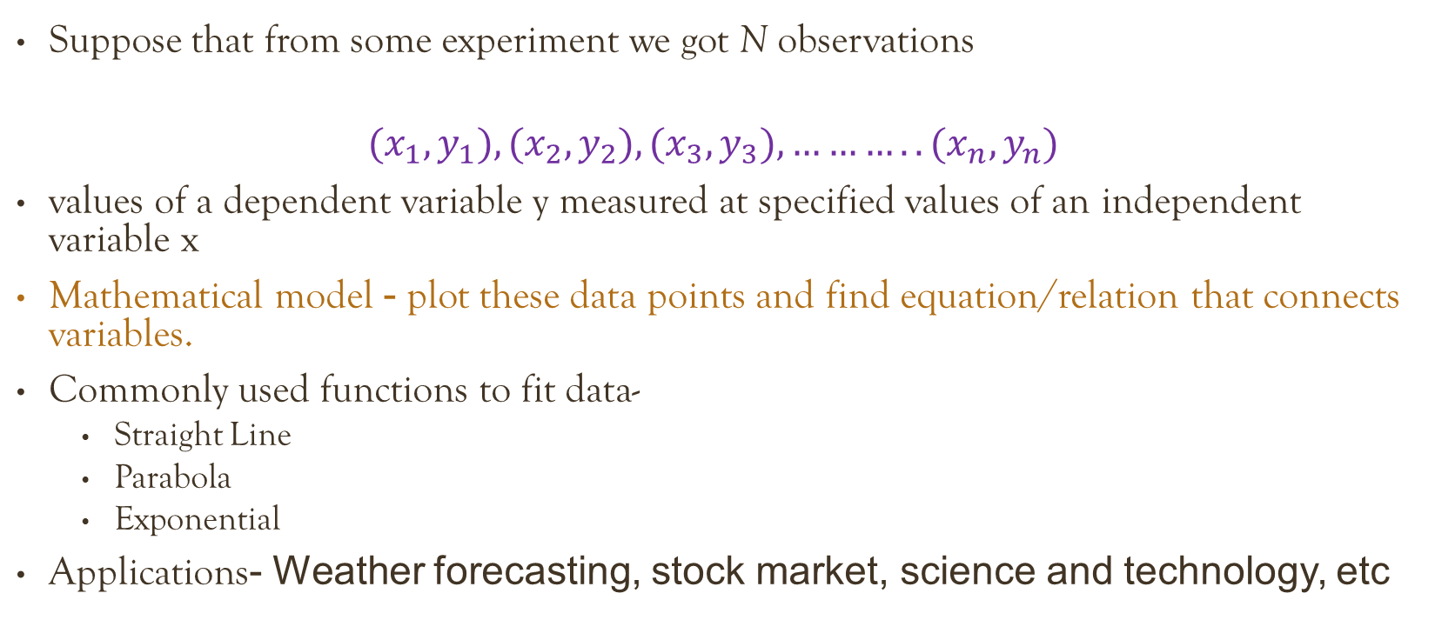
Curve fitting and Least Square Method-
Suppose that from some experiment we got N observations
$${(x}_{1},y_{1}), {(x}_{2},y_{2}), {(x}_{3},y_{3}), ………..{(x}_{n},y_{n})$$
values of a dependent variable y measured at specified values of an independent variable x
Mathematical model - plot these data points and find equation/relation that connects variables.
Commonly used functions to fit data-
Straight Line
Parabola
Exponential
Applications- Weather forecasting, stock market, science and technology, etc

Slide 3
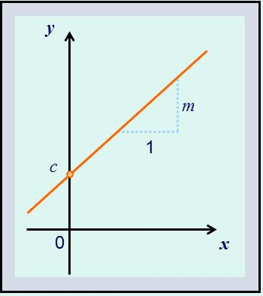
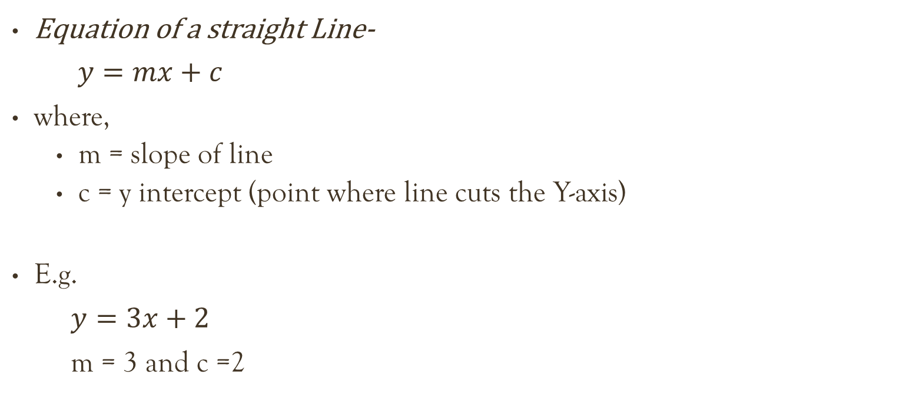
straight line
Equation of a straight Line-
$y=mx+c$
where,
m = slope of line
c = y intercept (point where line cuts the Y-axis)
E.g.
$y=3x+2$
m = 3 and c =2

Slide 4
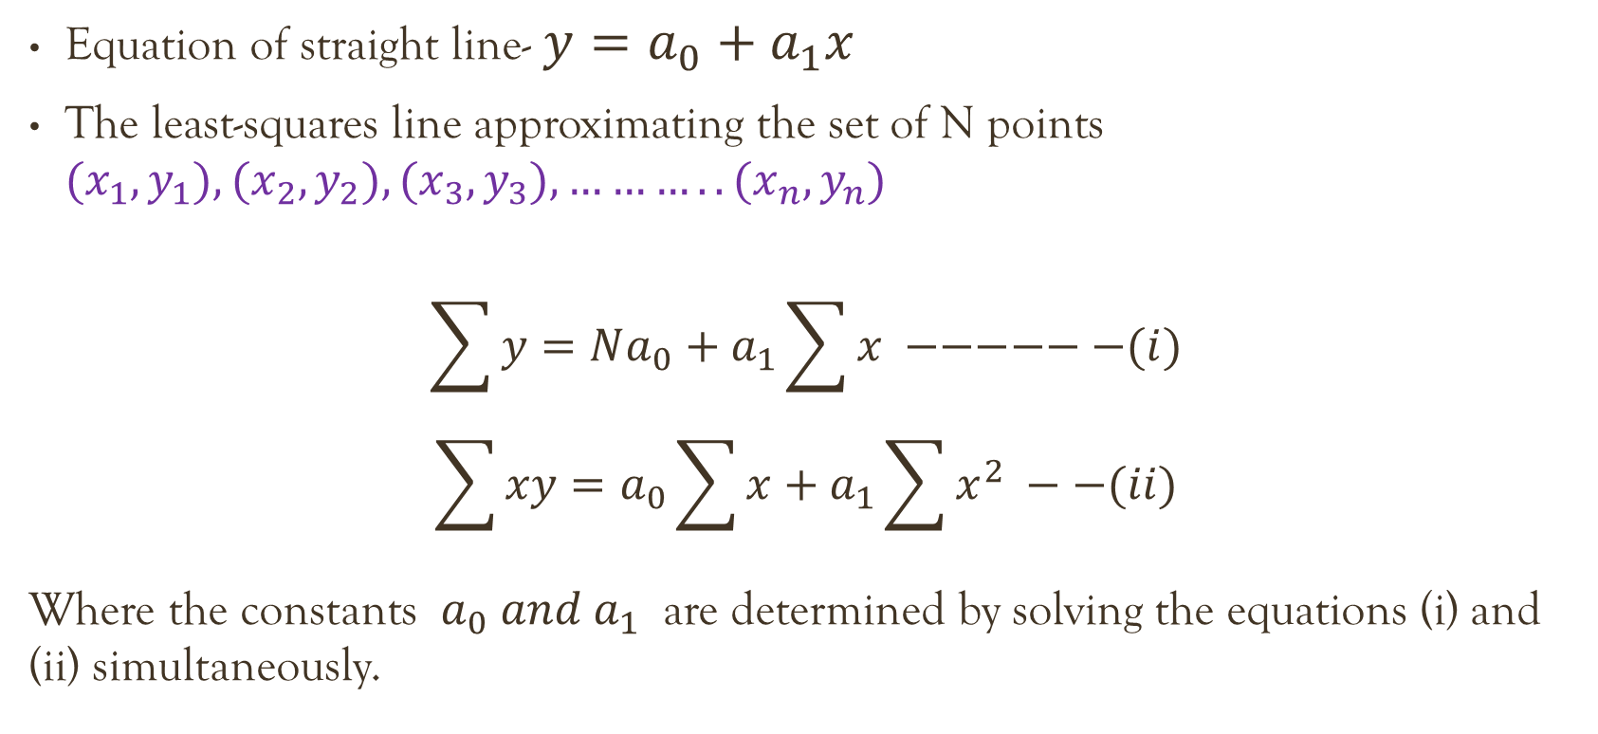
Least Square Line
y- Dependent, x- independent
Equation of straight line- $y=a_{0}+a_{1}x$
The least-squares line approximating the set of N points ${(x}_{1},y_{1}), {(x}_{2},y_{2}), {(x}_{3},y_{3}), ………..{(x}_{n},y_{n})$
$$\sum{y}=Na_{0}+a_{1}\sum{x} −−−−−−(i)$$
$$\sum{xy}=a_{0}\sum{x}+a_{1}\sum{x^{2}} −−(ii)$$
Where the constants $a_{0}$ 𝑎𝑛𝑑 $a_{1}$ are determined by solving the equations (i) and (ii) simultaneously.

Slide 5
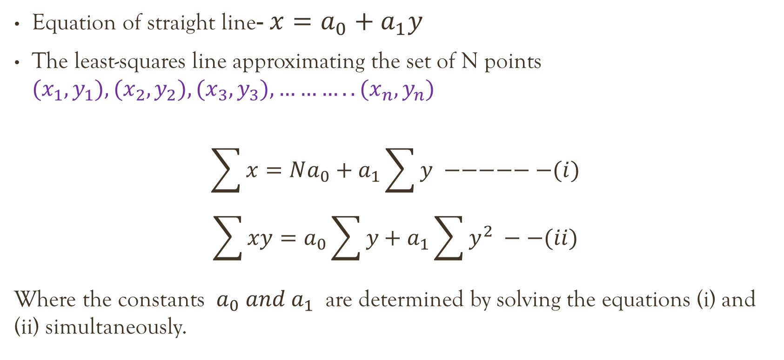
Least Square Line
x- Dependent, y- independent
Equation of straight line- $x=a_{0}+a_{1}y$
The least-squares line approximating the set of N points ${(x}_{1},y_{1}), {(x}_{2},y_{2}), {(x}_{3},y_{3}), ………..{(x}_{n},y_{n})$
$$\sum{x}=Na_{0}+a_{1}\sum{y} −−−−−−(i)$$
$$\sum{xy}=a_{0}\sum{y}+a_{1}\sum{y^{2}} −−(ii)$$
Where the constants $a_{0}$ 𝑎𝑛𝑑 $a_{1}$ are determined by solving the equations (i) and (ii) simultaneously.

Slide 6
Question
Fit a least square line to the data-
By using X as independent variable
By using X as dependant variable
X | 1 | 3 | 4 | 6 | 8 | 9 | 11 | 14
Y | 2 | 4 | 5 | 6 | 7 | 10 | 9 | 12

Slide 7
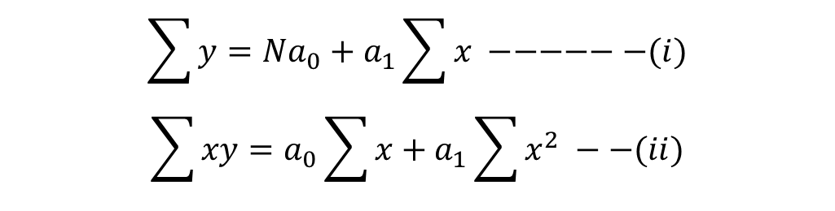
Solution
$$\sum{y}=Na_{0}+a_{1}\sum{x} −−−−−−(i)$$
$$\sum{xy}=a_{0}\sum{x}+a_{1}\sum{x^{2}} −−(ii)$$
y- Dependent, x- independent
Steps-
Write equations
Prepare a table
x
y
1
2
1
2
3
4
9
12
4
5
16
20
6
6
36
36
8
7
64
56
9
10
81
90
11
9
121
99
14
12
196
168
56
55
524
483

Slide 8
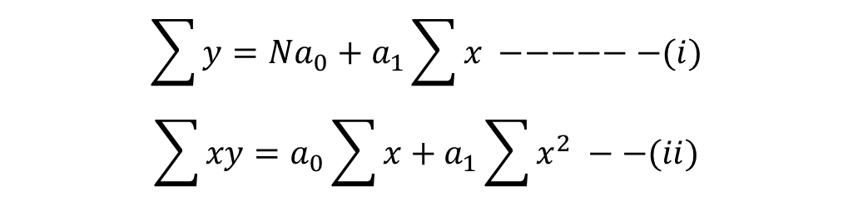

Cont. ..
$$\sum{y}=Na_{0}+a_{1}\sum{x} −−−−−−(i)$$
$$\sum{xy}=a_{0}\sum{x}+a_{1}\sum{x^{2}} −−(ii)$$
56
55
524
483
$55=8a_{0}+56a_{1}$ ------- (i)
$483=56a_{0}+524a_{1}$ ------- (ii)
Solve equations simultaneously,
$a_{0}$=1.678
$a_{1}$= 0.7424
Final Equation-
$$y=a_{0}+a_{1}x$$
$$y=1.678 +0.7424 x$$
y- Dependent, x- independent

Slide 9
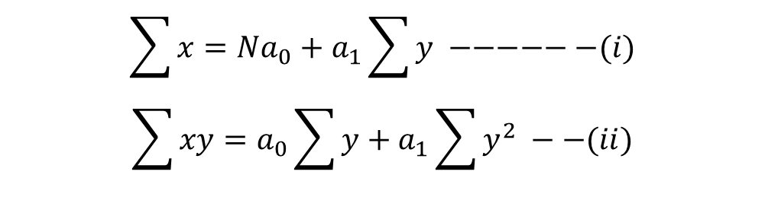
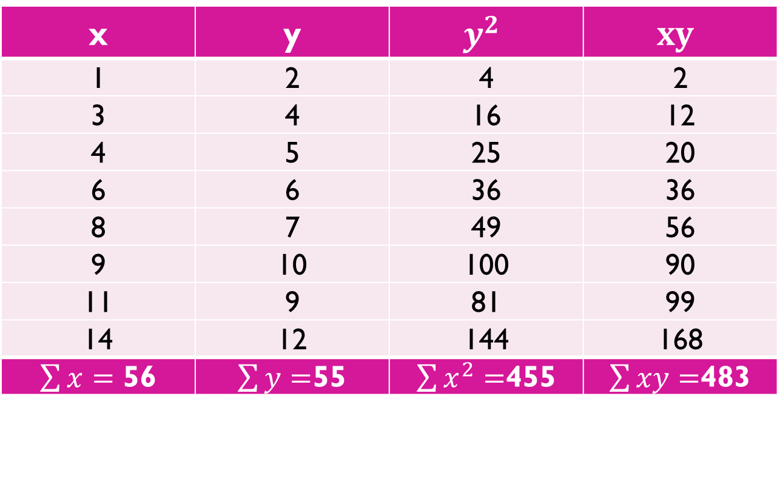
Solution
$$\sum{x}=Na_{0}+a_{1}\sum{y} −−−−−−(i)$$
$$\sum{xy}=a_{0}\sum{y}+a_{1}\sum{y^{2}} −−(ii)$$
x- Dependent, y- independent
Steps-
Write equations
Prepare a table
x | y | $$y^{2}$$ | $$xy$$
1 | 2 | 4 | 2
3 | 4 | 16 | 12
4 | 5 | 25 | 20
6 | 6 | 36 | 36
8 | 7 | 49 | 56
9 | 10 | 100 | 90
11 | 9 | 81 | 99
14 | 12 | 144 | 168
$\sum{x}=$ 56 | $\sum{y=}$55 | $\sum{x^{2}}=$455 | $\sum{xy}=$483

Slide 10

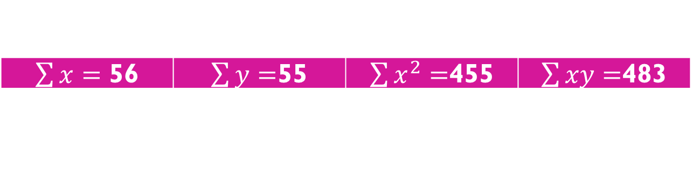
Cont.…
$$\sum{x}=Na_{0}+a_{1}\sum{y} −−−−−−(i)$$
$$\sum{xy}=a_{0}\sum{y}+a_{1}\sum{y^{2}} −−(ii)$$
$\sum{x}=$ 56 | $\sum{y=}$55 | $\sum{x^{2}}=$455 | $\sum{xy}=$483
$56=8a_{0}+55a_{1}$ ------- (i)
$483=55a_{0}+455a_{1}$ ------- (ii)
Solve equations simultaneously,
$a_{0}$= -1.7642
$a_{1}$= 1.2747
Final Equation-
$$x=a_{0}+a_{1}y$$
$$x=−1.7642 +1.2747 y$$
x- Dependent, y- independent

Slide 11
Question
Fit a least square line to the data-
By using X as independent variable
By using X as dependant variable
X | 3 | 5 | 6 | 8 | 9 | 11
Y | 2 | 3 | 4 | 6 | 5 | 8
Notes:
Y= -(1/3) + (1/5) x
X= 1 + (9/7) y

Slide 12
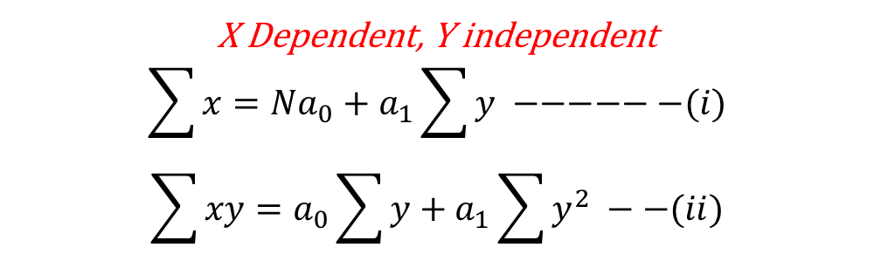
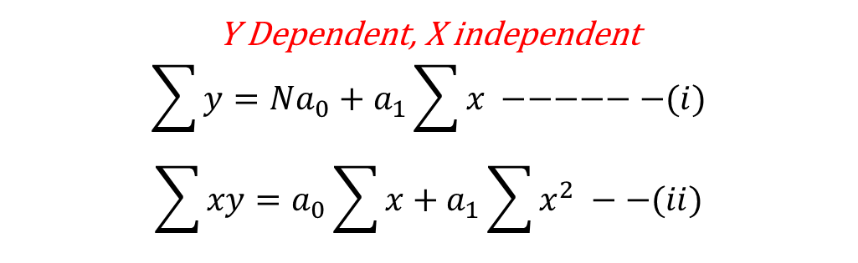
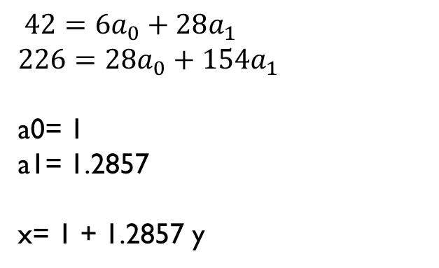

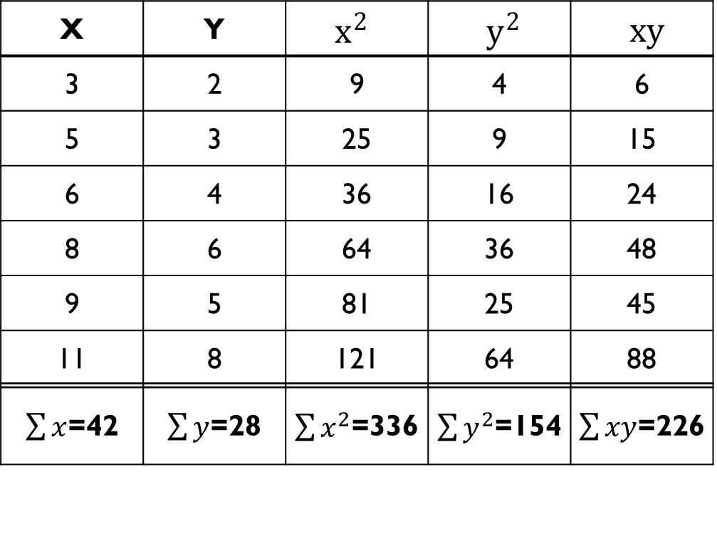
Y Dependent, X independent
$$\sum{y}=Na_{0}+a_{1}\sum{x} −−−−−−(i)$$
$$\sum{xy}=a_{0}\sum{x}+a_{1}\sum{x^{2}} −−(ii)$$
X Dependent, Y independent
$$\sum{x}=Na_{0}+a_{1}\sum{y} −−−−−−(i)$$
$$\sum{xy}=a_{0}\sum{y}+a_{1}\sum{y^{2}} −−(ii)$$
X | Y | $x^{2}$ | $y^{2}$ | $xy$
3 | 2 | 9 | 4 | 6
5 | 3 | 25 | 9 | 15
6 | 4 | 36 | 16 | 24
8 | 6 | 64 | 36 | 48
9 | 5 | 81 | 25 | 45
11 | 8 | 121 | 64 | 88
$\sum{x}$=42 | $\sum{y}$=28 | $\sum{x^{2}}$=336 | $\sum{y^{2}}$=154 | $\sum{xy}$=226
$28=6a_{0}+42a_{1}$
$$226=42a_{0}+336a_{1}$$
a0= - 0.3333
a1= 0. 7143
y = -0.3333 + 0.7143 x
$$42=6a_{0}+28a_{1}$$
$$226=28a_{0}+154a_{1}$$
a0= 1
a1= 1.2857
x= 1 + 1.2857 y

